Slide 1
Project Fly
Deepak Adhikari (68018)
Kshitiz Tiwari (68032)
<number>

Slide 2
Introduction
Newer approach to share files between laptops
Simplicity of bluetooth
Performance of Wi-fi
<number>

Slide 3
Problem statement
Bluetooth is simple to use but has disadvantage of
slower bandwidth
gets often disconnect when distance between devices increases
Access Point, AdHoc still complex
Access Point is not available everywhere
It is difficult to configure for normal users
Lacking an application that delivers simplicity of bluetooth and performance of WiFi
<number>

Slide 4
Objectives
To make file transfer between laptops simpler
To develop an application that gives intuitive user experience to share file
To make user friendly environment for establishing connection between laptops
<number>

Slide 5
Features
Easily establish connection between two laptops
Easily share files between laptops
Application has both GUI and CUI
Seamlessly works across GUI and CUI
<number>

Slide 6
Methodology
Divided our work into four phase
Socket study / implementation
Study of Wi-Fi Direct
Implementation of Wi-Fi Direct
Integration of Wi-Fi direct and Socket
<number>

Slide 7
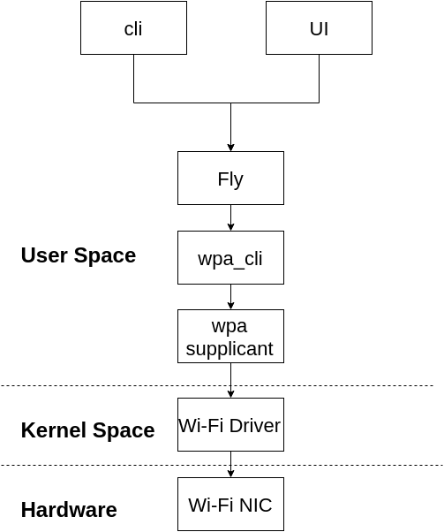
System Design
<number>

Slide 8
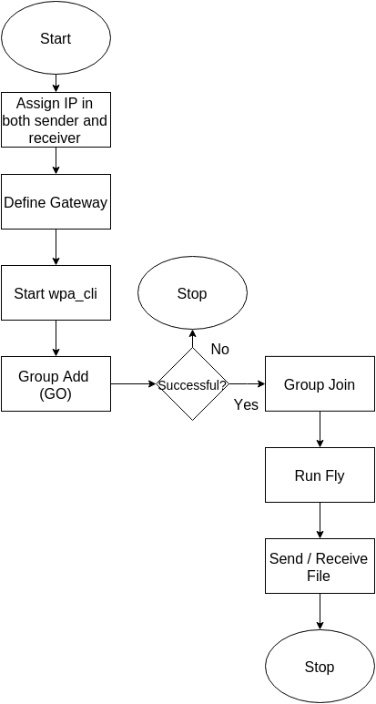
Program Flow
<number>

Slide 9
Send File
Get path of file to be send
Get address information
Create socket followed by set options and bind to establish connection
Wait for client socket connection
Open the file and send its contents in certain buffer size and EOF at the end
Send file name
Close file and socket
* For flow chart refer to page no: 23-24
<number>

Slide 10
Receive File
Get address information
Create socket followed by connect
Open temporary file
Start to write buffer contents until EOF is received
Rename temporary file name to the received file name
Close file and socket
* For flow chart refer to page no: 26-27
<number>

Slide 11
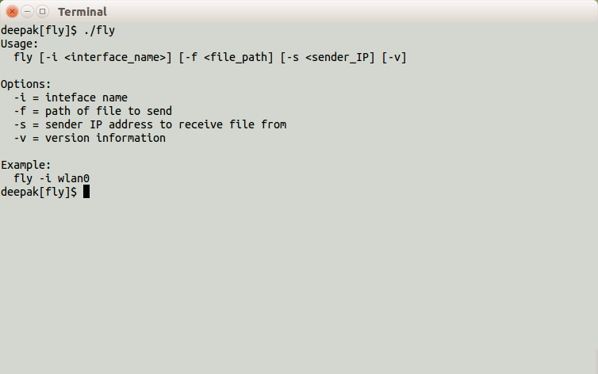
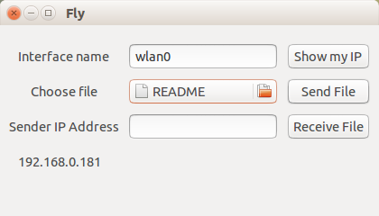
Output
Fly GUI
Fly CUI
<number>

Slide 12
Requirements
Hardware
Wi Fi Direct certified hardware for Group Owner
Legacy Wifi or Wifi certified for clients
Software
Machine running Linux alike OS
WPA supplicant
<number>

Slide 13
Conclusion
Wifi direct delivers simplicity of Bluetooth and at the same time Bandwidth performance of Wifi
Although OEM ships with Wifi Direct certification, connecting and sharing contents across different OEM is still difficult
Wifi is new and emerging technology. It will take some time to commonly use across all devices and become standard
<number>

Slide 14
Limitations
The application only works on Linux alike system
IP needs to be assigned manually
Character files can only be transferred
<number>

Slide 15
Future enhancements
Implementation of DHCP
Support across all Operating System
Transfer of file with any file format
Establish Wifi Direct connection from fly
<number>

Slide 16
Demo
<number>

Slide 17
Thank You
<number>

